Slide 1

Module four: Application testing
CIS 311 – Prof. C. R. Johnson

Slide 2
Security Architecture
A security architecture is a specification that is used as a guide to enforce security constraints
It specifies where security mechanisms (e.g., encryption, firewalls) need to be positioned in the software architecture
The quality of a security architecture also depends on the security of the applications that constitute the system

Slide 3
Security Architecture
Security architecture describes the position of security mechanisms in the software architecture and comprises:
subsystems
e.g., web servers, application servers, DBMS, directories, web applications, and legacy applications
communication links between the subsystems
e.g., local or remote function calls and protocols (SSL, HTTPS, LDAP)
position of security mechanisms
e.g., authentication and authorization points, encryption methods, audit, logging, monitoring, intrusion detection, registration, backup, recovery

Slide 4
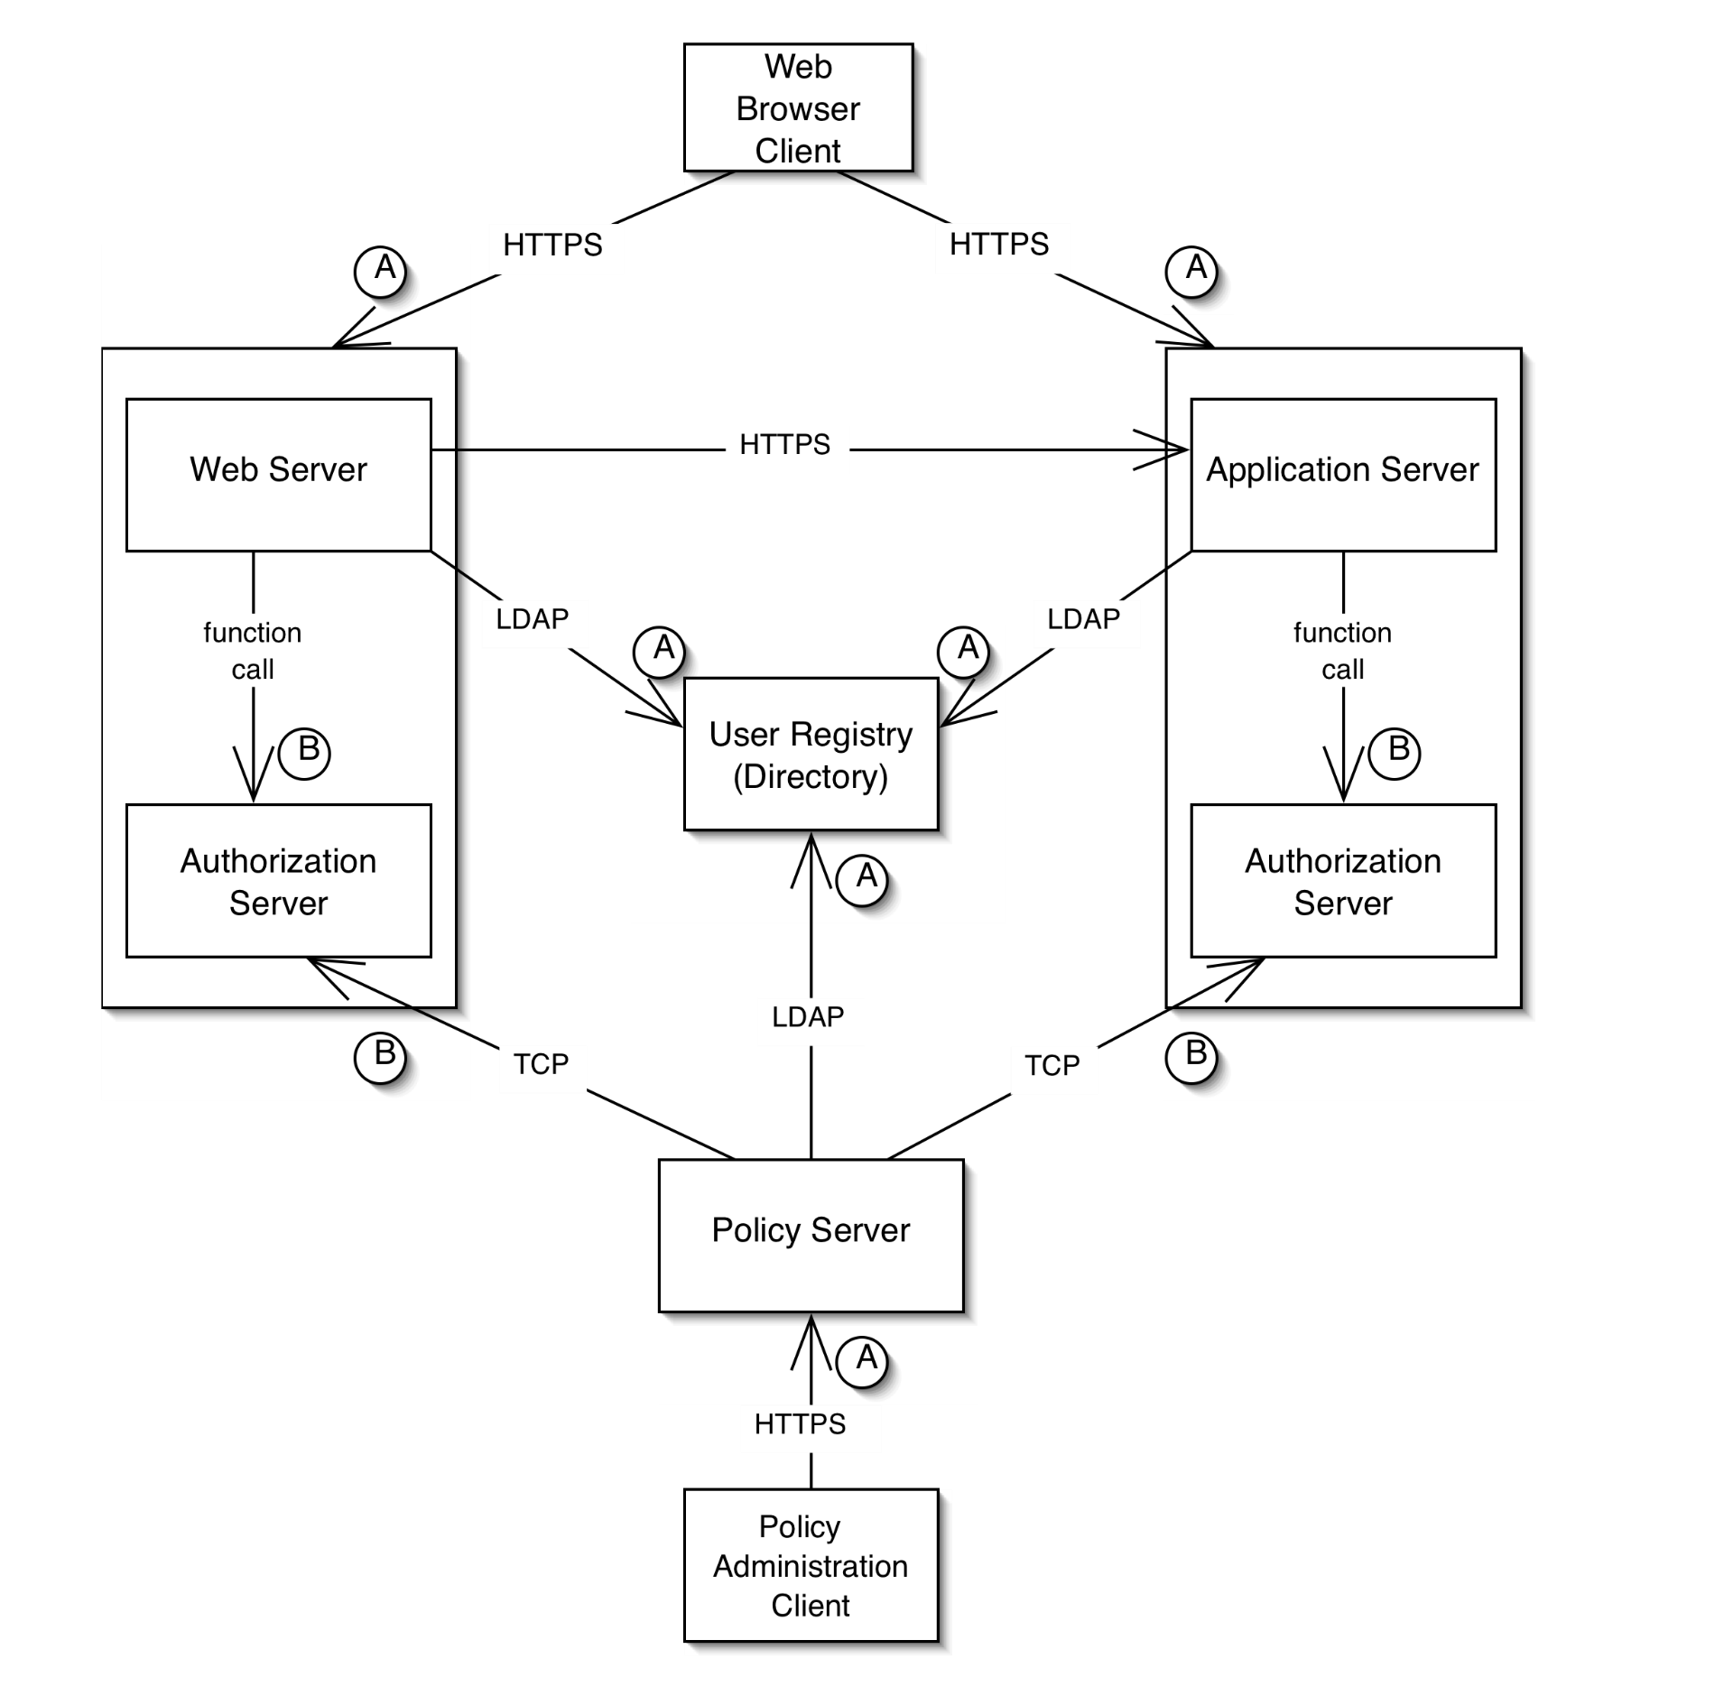
Example of a Security Architecture Diagram

Slide 5
Validating Security Architecture
There are many security faults that arise from a poorly designed security architecture, e.g.,
unauthorized access to data and applications
confidential and restricted data flowing as unencrypted text over network connections
Security architecture is validated using a process called threat modeling.
Threat modeling is typically a manual (i.e., not automated) inspection process, similar to code and requirements inspection.

Slide 6
Creating a Security Testing Project
Threat Models
Test plan
Test cases
Problem reports
Postmortem

Slide 7
*Threat Modeling
A way of categorizing and analyzing the threats to an application
What information will a threat model help to provide?
Which assets need protection
What threats is the application vulnerable to
How important or how likely is each threat
How can the threats be mitigated
Notes:
Assets: hardware, software, and data on a computer or network

Slide 8
STRIDE - Model of Threat Categories
Spoofing identity - Illegal use of another person's authentication information, such as a user name or password.
Tampering with data - malicious modification of data
Repudiation - Users deny performing an action
Information Disclosure - exposure of information to unauthorized individuals
Denial of Service - explicit attempt to prevent legitimate users from using a service or system.
Elevation of Privilege - an unprivileged user gains privileged access
Notes:
Helps in the development of threat models. These are items that should be taken into consideration.

Slide 9
Threat modeling
Threat Modeling is a process for evaluating a software system for security issues.
It is a variation of the code and specification inspections processes discussed earlier in the course.
The goal is for a review team to look for software features that vulnerable from a security perspective.
Threat modeling is not the responsibility of a software tester, although testers may be involved in the security review team.

Slide 10
Threat modeling process (1)
Assemble the treat modeling team
Include security experts and consultants
Identify the assets
E.g., credit card numbers, social security numbers, computing resources, trade secrets, financial data
Create an architecture overview
Define the architecture and identify the trust boundaries and authentication mechanisms
Decompose the application
E.g., identify data flows, encryption processes, password flows.

Slide 11
Threat modeling process (2)
Identify threats
E.g., can data be viewed, changed? Limit access of legitimate users? Unauthorized access of the system?
Document threats
E.g., describe threat, target, form of attack, counter-measures to prevent an attack, etc.
Rank threats (scale: low, medium, high)
Damage potential
E.g., property, data integrity, financial loss
Reproducibility
E.g., probability that an attempt to compromise the system will succeed
Exploitability/Discoverability
E.g., is it difficult to hack into the system?
Affected users
How many users will be affected? Who are these users? Are they important?

Slide 12
Partial Threat Tree
Notes:
At a high level the threat is that an attacker will bypass the authentication or brute-force the password field for a known user.
This figures shows the conditions necessary to realize this threat.
For example, if both conditional 1.a. and 1.b hold, then can then gain unauthorized access to a user’s account.

Slide 13
*Build a Test Plan
Includes high level overview of test cases
Identifies components to be tested
States how exploratory testing will be done
Test design and test execution at the same time
Plan must also address
Logistics
Deliverables
Test cases and tools
Notes:
Logistics: Project schedule, People, Resources, Equipment, Testing schedule
Deliverables: Description of all deliverables and their associated timetable. Includes Problem reports & final report
Test Cases:
Based on the threat model for application
Test cases tied to application risks
Identifies tools required to conduct testing
Includes identification of automated testing tools

Slide 14
*Execute Test Cases
Dependency testing
User interface testing
Design testing
Implementation testing
Notes:
Test cases fall into one of 4 categories

Slide 15
Dependency Testing
Dependency testing exposes insecurities related to external resources
File systems
Registry
External libraries
Types of insecurities that can arise
Denying the application access
Tampering with and corrupting data
Notes:
Applications often rely on external resources to behave securely.

Slide 16
User Interface Testing
Parameter tampering testing
Changing the data within a parameter sent from one Web page to another
Command injection testing
Manipulating input data sent to a Web server
Buffer overflow testing
Data sent as input to the server that overflows the boundaries of the input area
Notes:
User interface testing delivers input to the software the way developers anticipated via the command window, text fields, buttons, etc. The objective here is to test corrupt and unanticipated inputs.

Slide 17
Design Testing
Helps to identify design errors
Unsecured ports
Default accounts
Notes:
Privileges: Each user and each program should operate by using the fewest privilege possible. In this way, the damage from an inadvertent or malicious attack in minimized.
Incomplete Mediation: Every access must be checked (direct access attempts (requests) as well as attempts to circumvent the access checking mechanism must be considered.

Slide 18
Implementation Testing
TOCTOU – time-of-check-to-time-of-use
A time gaps exists between when an application checks security on a particular function or piece of data and when that privilege is exercised
Notes:
Even if an application’s design is secure, many bad things can occur when developers make specific implementation choices or errors.
Example – suppose a user is requesting access to a file. While the mediator is checking access rights for the file, the user could change the file name. The mediator approves the request based on the initial information provided. The mediator would now send the now-modified descriptor to the file handler. Between the time the access was checked and the time the result of the check was used, a change occurred, invalidating the result of the check.

Slide 19
*The Problem Report
Must include
Reproduction steps
List the steps that another tester/developer must follow to reproduce the failure
Severity
What is the potential result of the failure
Exploit scenarios
The specific sequence of things an attacker can do to take advantage of a security flaw and the consequences of doing so

Slide 20
*Postmortems
Includes a discussion by the testing team of the bugs found
Identifies improvements to the testing process so that bugs are found sooner in future security testing
Performed after a project is complete
Performed periodically for released products when bugs are uncovered in the field

Slide 21
Auditing for software security
Pre-release software development practices unlikely to change
Safe languages
Adequate software design
Thorough testing
Post-release auditing typically used if warranted
Notes:
Due to economic motivations and software development purposes the pre-release process is unlikely to change.
If there is reason to believe that software has security issues, a security audit may be performed.
If we can reduce the cost and efficiency of audits, developers may be more inclined to use them for preventative measures.

Slide 22
Security auditing problems
Large scale auditing infeasible due code size
Good source code will have 1-3 bugs for every 100 lines of code
Security auditors need to find the software security vulnerabilities in the bugs
Security audits would benefit from a tool that identify areas that are likely vulnerable
Notes:
Due to the code size of large scale systems, auditing is infeasible. Therefore auditors must use their expertise to find areas which could pose a problem. If the system is poorly documented, has been maintained poorly, or gone through a period of rapid feature development auditing becomes a problem of reverse engineering.
Bezier states that for every hundred lines of code in good code there will be 1 to 3 bugs. If the bugs do not violate an explicit or implicit security policy it is not a security vulnerability and therefore of no concern to a security auditor.
Locating security vulnerabilities is a task that requires a lot of manual code browsing and flow tracing.
Security audits would benefit financially, temporally, and rigorously from a tool which locates those areas of code which have been shown to be statistically more vulnerable.

Slide 23
Improving the security audit
Cut down the amount of code needed to be reviewed
Ensure high degree of accuracy
Bottom line: Complexity reduction
Notes:
Managers, why are we here? To address the problem of security vulnerabilities in code.
This problem is going to be addressed with the tools based on sound research.
Reduce the complexity (and thus the time and expense) of security auditing
Manager/Director this research and tools are aimed at improving software security by reducing the complexity of a software audit

Slide 24
The FLF hypothesis
A small percentage of functions near a source of input are more likely to contain software security vulnerabilities
These functions are known as Front Line Functions
Input
FLF
FLF
FLF
Notes:
Lets review the FLF hypothesis again.
Those functions involved with user input are suspect.
These functions constitute a small percentage of the entire system.
At some point following the data provides little benefit from a security standpoint.
We need to validate our hypothesis

Slide 25
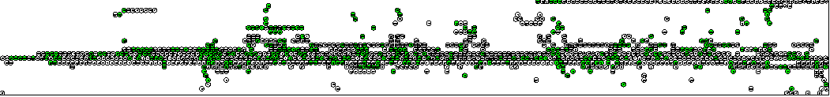
Front line functions
60% Code Reduction
No auditor time required
High degree of accuracy
Notes:
Graph of functions in openBSD 3.1
Green function represent function with a high likelihood of vulnerability (Front Line Functions)
A tool would simply list the suspect functions

Slide 26
Discovering the FLF measurement
Collect software systems with known vulnerabilities
Perform detailed static analyses of software systems
Calculate areas of likely vulnerability from information gathered during static analyses
Build tools around these calculations

Slide 27
How are these tools used?
Run static analysis tools on source code
A database of code facts is created
The database is used to find the likely vulnerable functions
The likely vulnerable functions are outputted and ranked by proximity to input source
Notes:
Lets do a case study to illustrate how these tools are used.

Slide 28
Case Study: OpenSSH
GOAL: FLF Finder identifies large percentage of modified functions
Code that was not change between revisions
OpenSSH 3.1
OpenSSH 3.2.3
Code changed to implement privilege separation
Functions where privilege separation will be implemented
82% of changed functions identified by FLF Finder
Notes:
PRIVELEGE SEPARATION: Between revision 3.1 and 3.2.3, OpenSSH went through changes that struggle to separate code that needed “root” access from code that did not need “root” access
AFTER REV.: Code that implemented privilege separation
BEFORE REV.: These are functions that were changed during the revision
GOAL: The FLF Finder should find a large percentage of those functions that were changed
This means that our findings agree with the security auditors of OpenSSH on what is a likely vulnerable function
A security auditor could use our tools and methods to find those areas of code that are statistically likely to be vulnerable.

Slide 29
Experimental Systems
30 open source systems
31 software security vulnerabilities
Each system has a single patch file which addresses one security vulnerability
Most recovered from Redhat’s source RPM distribution due to their incremental nature
Notes:
SINGLE PATCH FILE: If a certain piece of software had a security vulnerability introduced by an off by one error, then we would try to find the smallest patch which addressed this off by one error
SINGLE PURPOSE PATCHES HARD TO FIND: Because most developers have a set of other bug fixes ready to be released when a security vulnerability is found, finding singular patch files which addressed security vulnerabilities was difficult
SRPMS: Redhat has a certain system of incremental patches which were very useful

Slide 30
GAST-MP & SGA
GNU Abstract Syntax Tree Manipulation Program ( GAST-MP )
Source Code Analysis tool
Operates on G++’s Abstract Syntax Tree (AST)
AST can be outputted with the –fdump-tree-flag
Creates a repository of code facts
System Graph Analyzer ( SGA )
Operates on the code fact repository
Identifies Inputs and Targets
Performs invocation analysis
Calculates FLF Density
Analysis of Categorical Graphs
Notes:
GAST-MP: Builds a entity/relationship repository which can be queried
SGA: System Graph Analyzer
OPERATES ON REP: Queries the repository, to build internal graphs.
FLOW ANALYSIS: These graphs can then be analyzed through flow analysis
Because of the detail within the AST, our tools can perform analysis that typically is hard to do.
Pointer aliasing
Dataflow through function boundaries

Slide 31
Finding inputs
An Input is a function which contains reads in external user input
For example, read
A list of external function calls were compiled to properly identify Inputs
This list could be modified to contain application specific library calls
Notes:
1. INPUT FUNCTIONS: These functions are functions like read, scanf, recv, and getopt coming from unistd.h, stdio.h, getopt.h, stdlib.h, socket.h

Slide 32
Finding targets
A Target is any function that contains a known vulnerability
Targets are found by matching code facts on subtractive lines in a patch file with code facts in the repository generated by GAST-MP
--- channels.c 27 Feb 2002 21:23:13 -0000 1.170
+++ channels.c 4 Mar 2002 19:37:58 -0000 1.171
@@ -146,7 +146,7 @@
{
Channel *c;
- if (id < 0 || id > channels_alloc) {
+ if (id < 0 || id >= channels_alloc) {
log("channel_lookup: %d: bad id", id);
return NULL;
}
Notes:
SUBTRACTIVE LINES: In this example, all the entities on the subtractive line would be noted as vulnerable. Therefore, the function which contains this subtractive line is a target.

Slide 33
FLF density
Create entire call graph G
Transform G in DAG
Label Input and Target Nodes
Calculate invocation paths between Input and Target combinations and measure length
Calculate FLF Density by normalizing path length by function cardinality
For each system choose the largest FLF Density
Notes:
The FLF Density represents those functions that handled data which was used in a security vulnerability

Slide 34
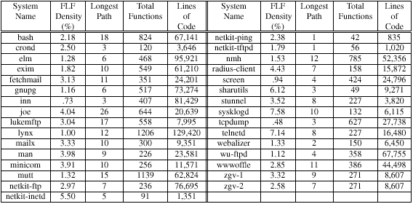
Experimental results
Notes:
The longest path is the longest achievable invocation path between an input and a target.
NORMALIZING FACTOR: We choose function cardinality as a normal because, function cardinality seems to be an accurate representation of function complexity. When path lengths become larger it is an indication of functional complexity and therefore scaling by function cardinality gives a good metric.
WHY NOT PATH LEGNTH: Other suggestions for a normal were longest path and average path. The longest path in a system is implicitly an outlier and therefore not a good normalizing factor. The average path length is a time consuming normalizing factor to compute

Slide 35
Experimental results
Sample mean FLF Density 2.87%
Therefore, a very small number of functions are actually likely to be vulnerable
Standard deviation of 1.87%
The FLF density was consistent across our experimental systems
With 95% confidence the true mean is between 2.23% and 3.51%
There is a high probability that our experimental density is close to the TRUE FLF Density
Notes:
CONFIDENCE: The 95% Confidence is important because the interval is very small

Slide 36

Verification
The FLF Density can be used as a conservative way to highlight those vulnerability functions which do not have known vulnerabilities
Notes:
FLF DENSITY CHECK: These three systems all had security vulnerabilities but were reserved to test the FLF Density
Dhcpd was missed due to function pointers

Slide 37
FLF finder
FLF Density can say what areas of code are statistically likely to be vulnerable
Automate tool to find these areas
Targets are not provided – what do we do?
Assume all functions are targets
This extremely conservative assumption is still able to reduce 60% of code!

Slide 38
Research Challenges
Formal Security Architectures
“The software maintenance community is challenged to investigate the creation of a suite of tools to model and simulate the behavior of security architectures as well as support the verification of properties that are relevant to security”
Security Attack Diagnosis and Mitigation
“The software maintenance community is challenged to investigate techniques that will enable software to self-diagnose security attacks and self-mitigate the effects of these attacks at run-time”

Slide 39
Formal Security Architectures
The security architectures of industrial-strength software systems are specified using natural language and informal diagrams
These security architectures are validated using manual inspection processes
A barrier to the automation of the analysis of security architectures is the absence of formalism in the notations used in practice to describe security architectures.

Slide 40
Formal Security Architectures
Future notations and tools to support security architecture may involve:
Formal modeling notations to specify security architecture
Tools to simulate the execution behavior of software security models
Candidate technologies: Generic Modeling Environment (GME) and Ptolemy.
Model checking tools to verify properties of security architecture
A candidate technology: Bogor.

Slide 41
Security Attack Diagnosis & Mitigation
Servers and applications developed using secure coding may still not respond adequately to security attacks at run time
The capacity of a server to diagnose security attacks automatically before it is exploited is important
especially if the server is used in a safety-critical domain
Self-mitigation strategies are also needed to enable software to continue functioning
especially if applications and servers are deployed in contexts where patching and re-starting the software is not a practical option

Slide 42
Toward Security Attack Diagnosis & Mitigation
Develop software sensors that monitor various aspects of the execution behavior of software
Create formal self-diagnostic models based on deviations from a software’s expected behavior
Automatically disable software features and enable security mechanisms at run time in response to diagnosed security attacks
Evolve the diagnostic and mitigation capabilities of software over time by learning from their past experiences

